Slide 1
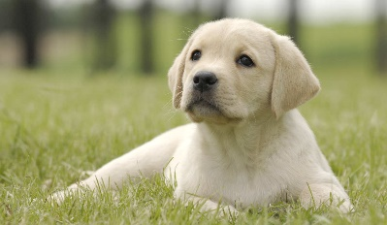
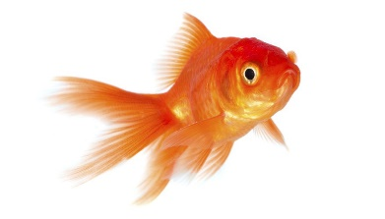
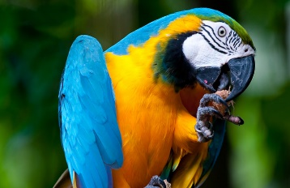
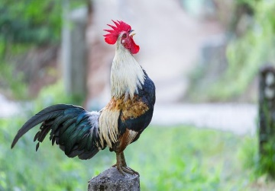
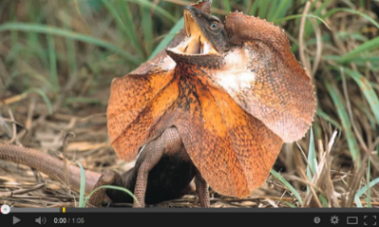
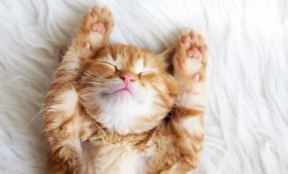
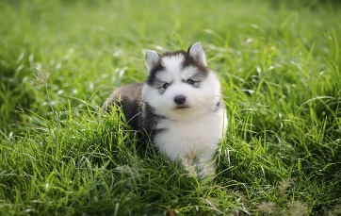
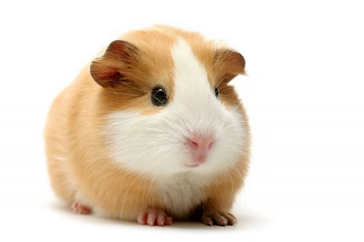
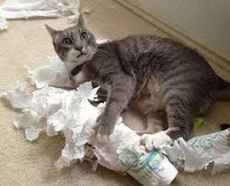
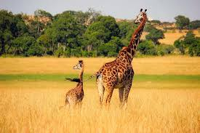
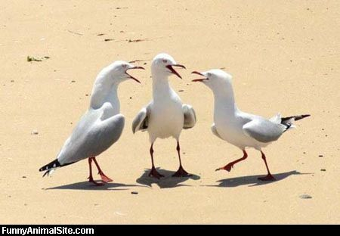
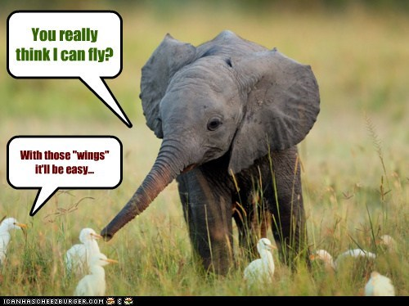
Warm up
Questions
Which of these make suitable pets? Why?
Do you have a pet? What kind of pet suits your personality?
Which kind of pet do western people favour?
Are you a dog or a cat person?
Solve in a creative way, solve in a calm way, solve in an unusual way
A lesson
Recall a discussion

Slide 2
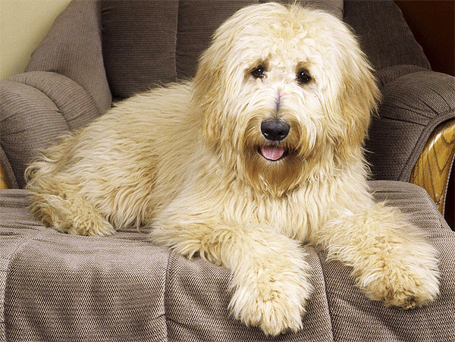
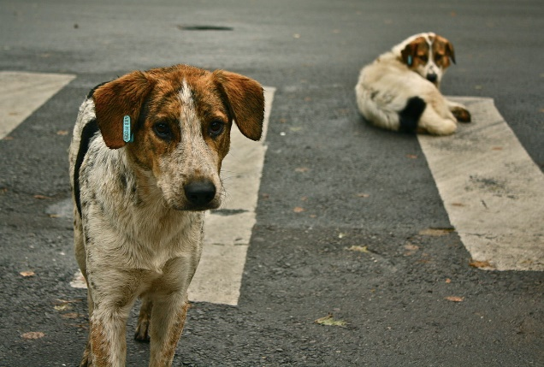
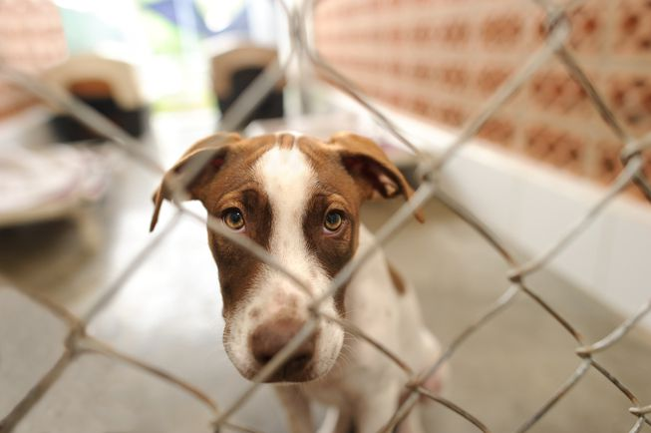
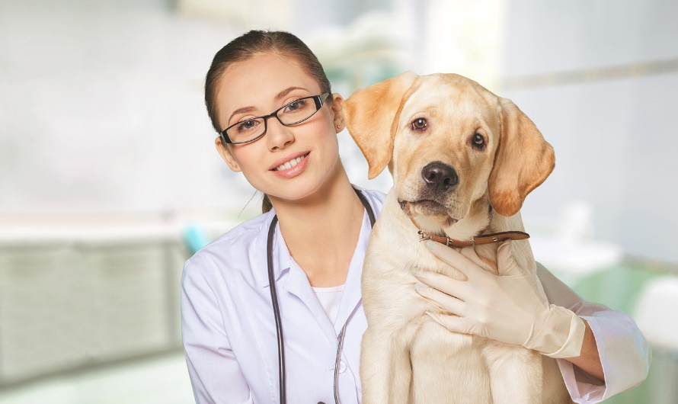
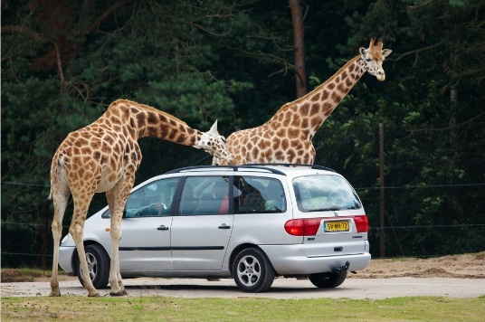
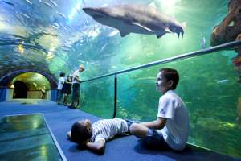
Creative thinking
Word list
Vet
Safari park
Animal Shelter
Aquarium
Fur
Abandon
What are the differences between a cat person and a dog person?
The early bird catches the worm
Don’t count your chickens before they hatch
3. You cant teach an old dog new tricks
4. His bark is worse than his bite
5. You can lead a horse to water, but you cant make it drink
6. A leopard doesn’t change its spots

